Slide 1
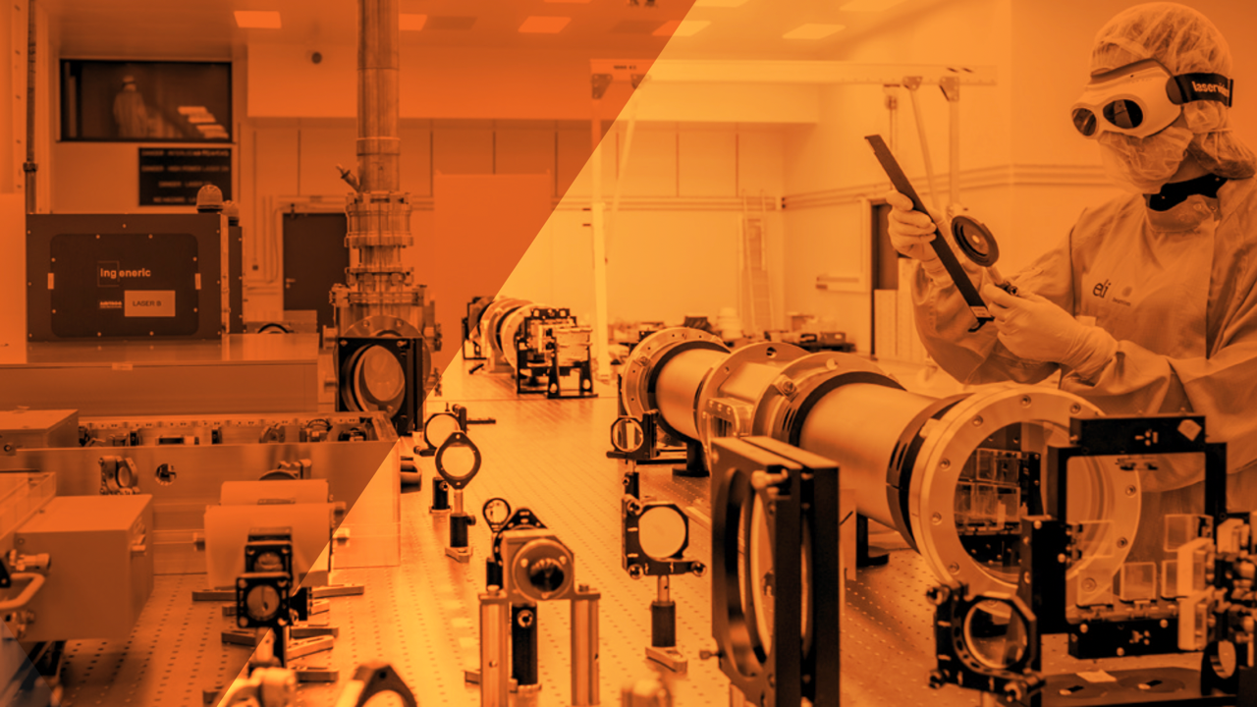

Advancing the Frontiers of Extreme Light
ELI-Beamlines 2025

Slide 2
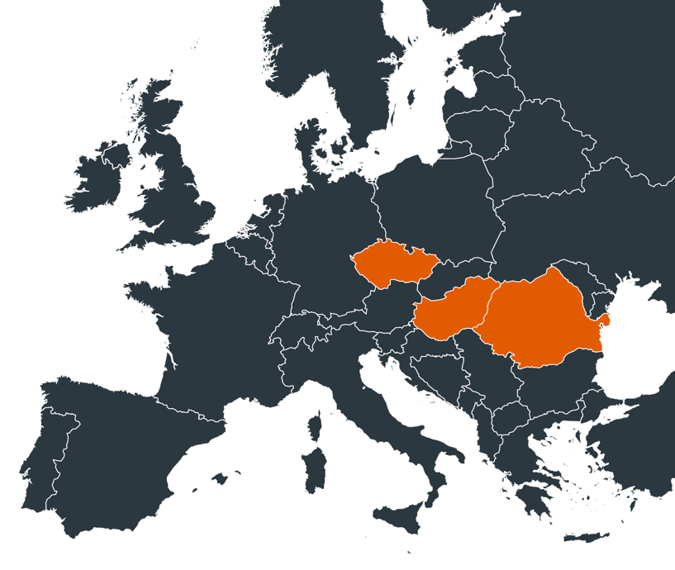
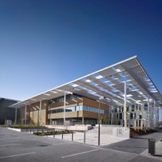
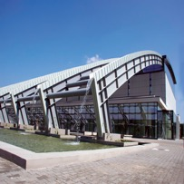
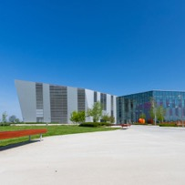
Extreme Light for Europe
ELI Beamlines
Femtosecond Laser Pulse
ELI Beamlines, Dolní Břežany, Czechia ~10km from Prague center
Attosecond Laser Pulse
ELI ALPS, Szeged, Hungary
Nuclear Science
ELI NP, Magurele, Romania
ELI NP
ELI ALPS

Slide 3
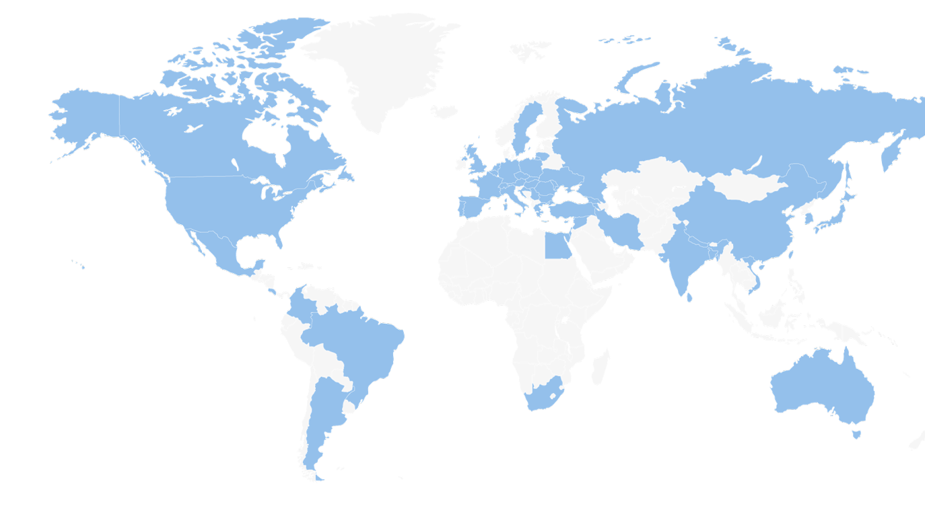
ELI ERIC as an Employer
37
631
Scientific personnel
Technicians/Engineers
Nationalities
Employees
Administrative personnel

Slide 4
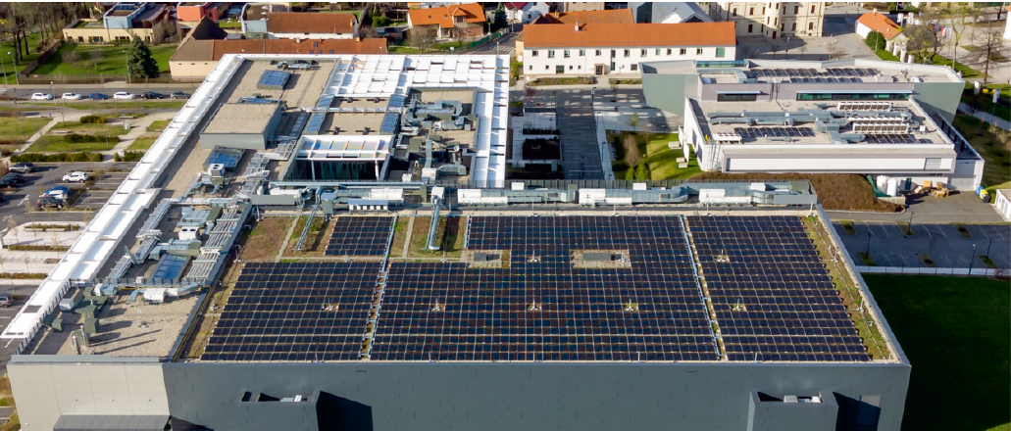
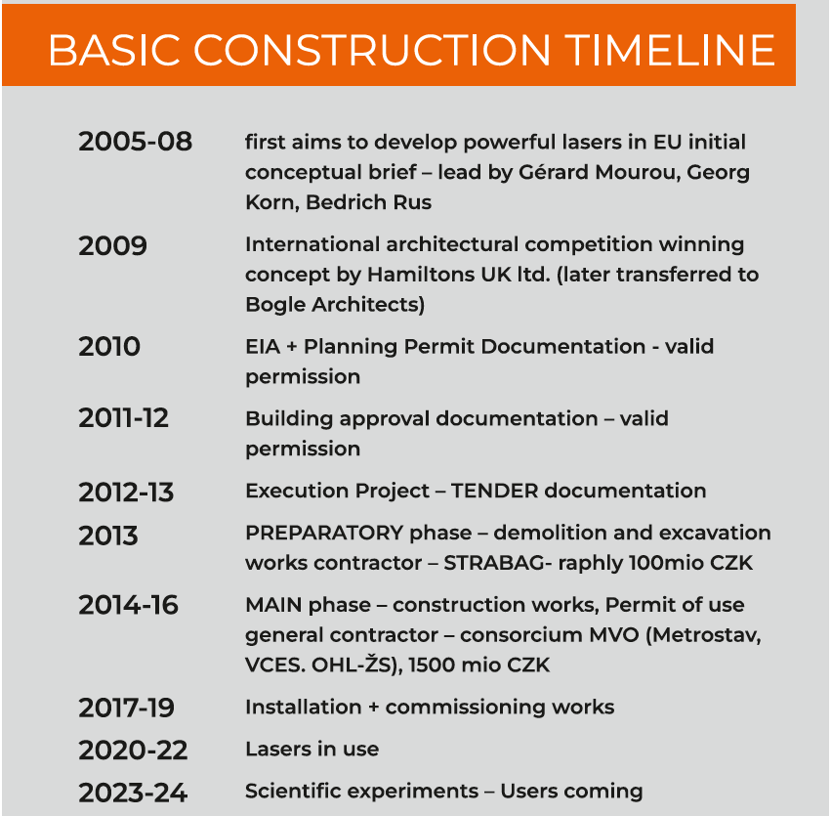
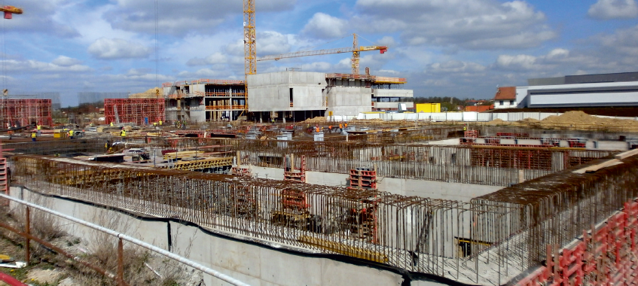
ELI Brief Building Introduction

Slide 6
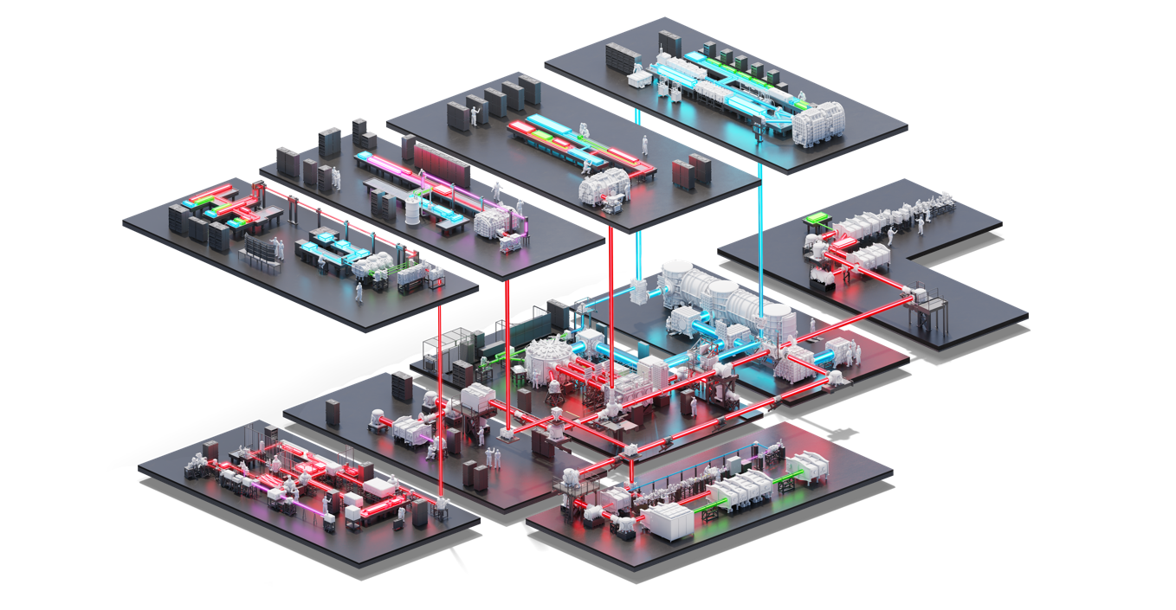

L4
L3
L2
L1
E4
E3
E2
E1
L4c
E5
ELI Beamlines facility

Slide 7



ELI-Beamlines Lasers
L1
1 kHz
15 fs
30 mJ
L2
20 Hz
25 fs
2 J
L3
3.3 Hz
27.3 fs
13.3 J
L4
1 spm
0.5 ns
1.2 kJ

Slide 8
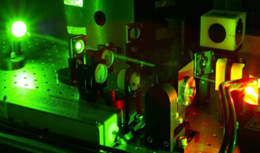
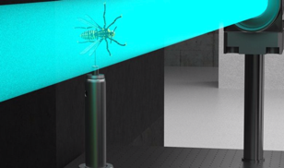
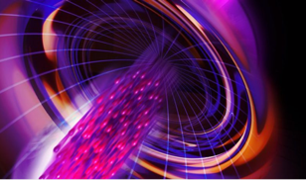
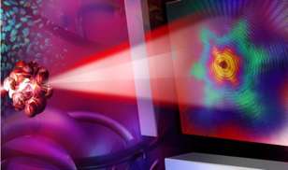
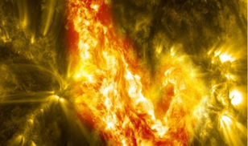
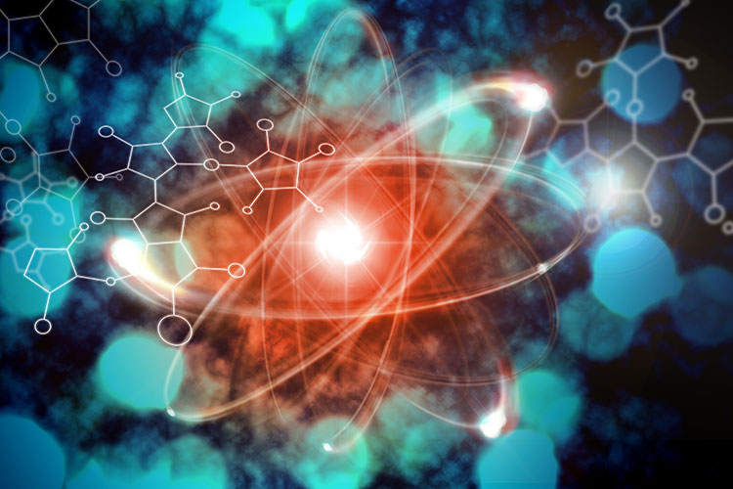
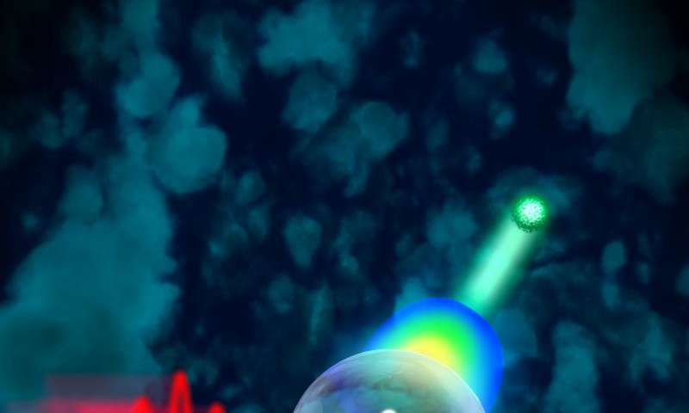
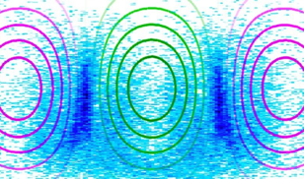
Science in ELI
Laser science
Particle Acceleration
Materials Science, Biology
VUV, EUV, RTG
Nuclear Physics
Plasma, HED Physics, Fusion Physics, Astrophysics
Attosecond
Dynamics
Theory, Computations, Simulations

Slide 9
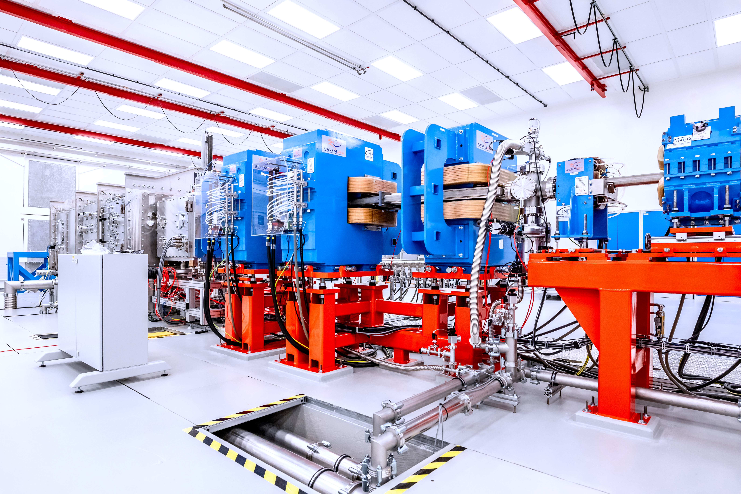
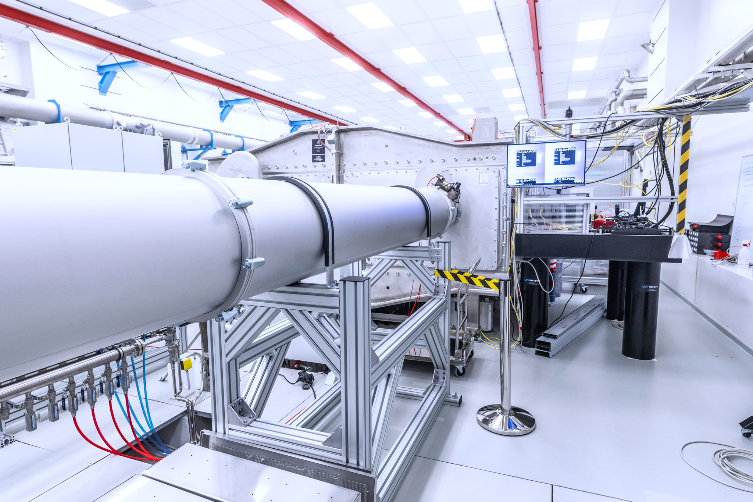
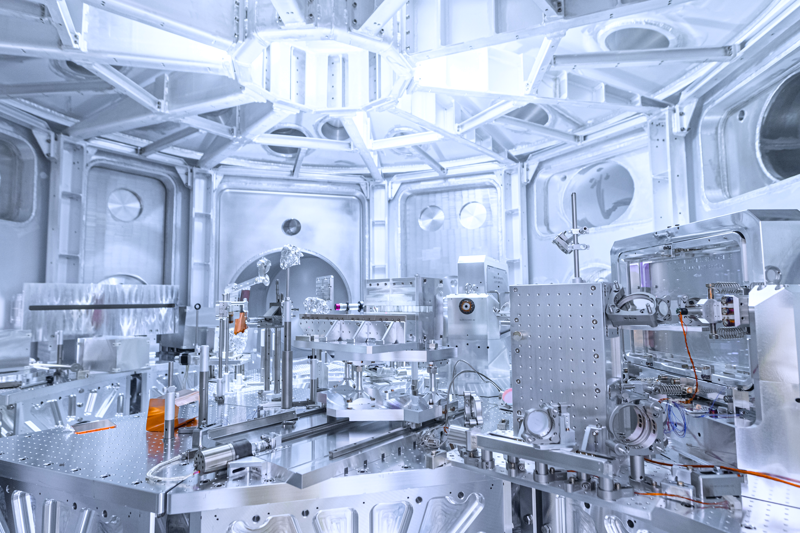
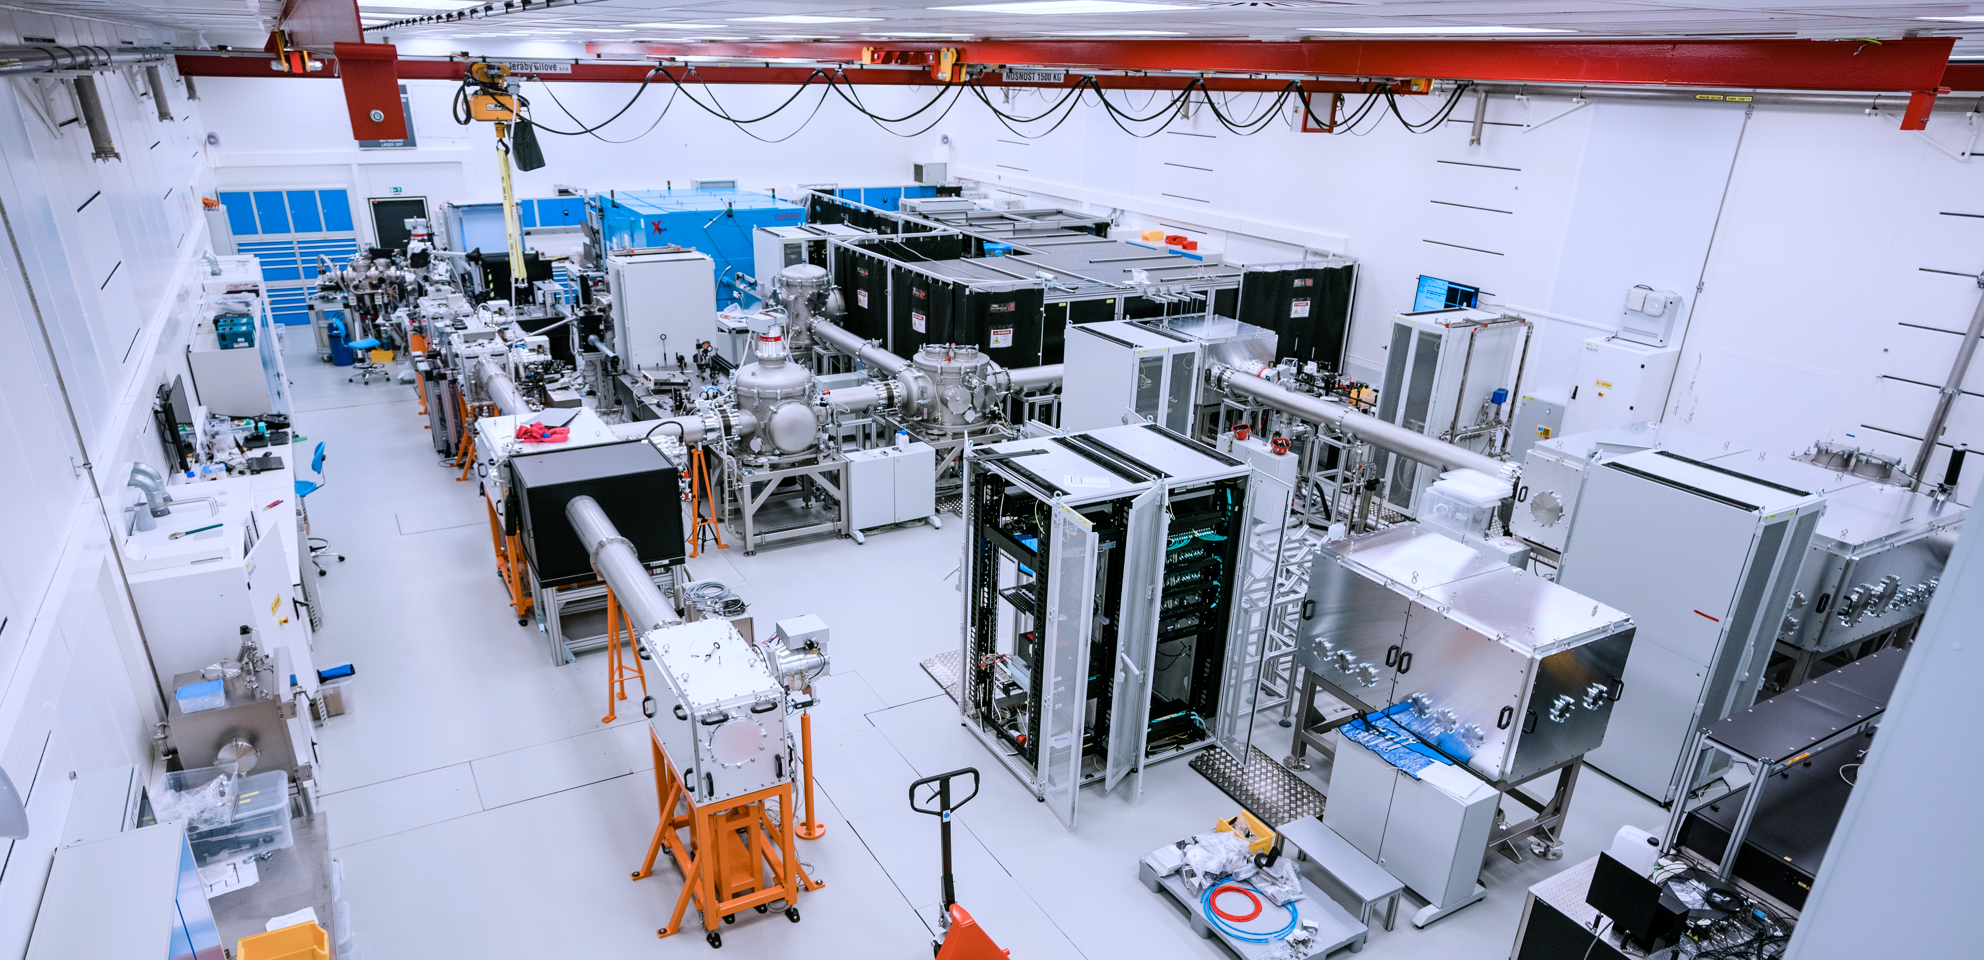

Slide 10




Control System History
History
CS Laser Team
LabView
Pilz
CodeGenerator
Experimental CS Team
B&R PLC
Tango
C++

Slide 11
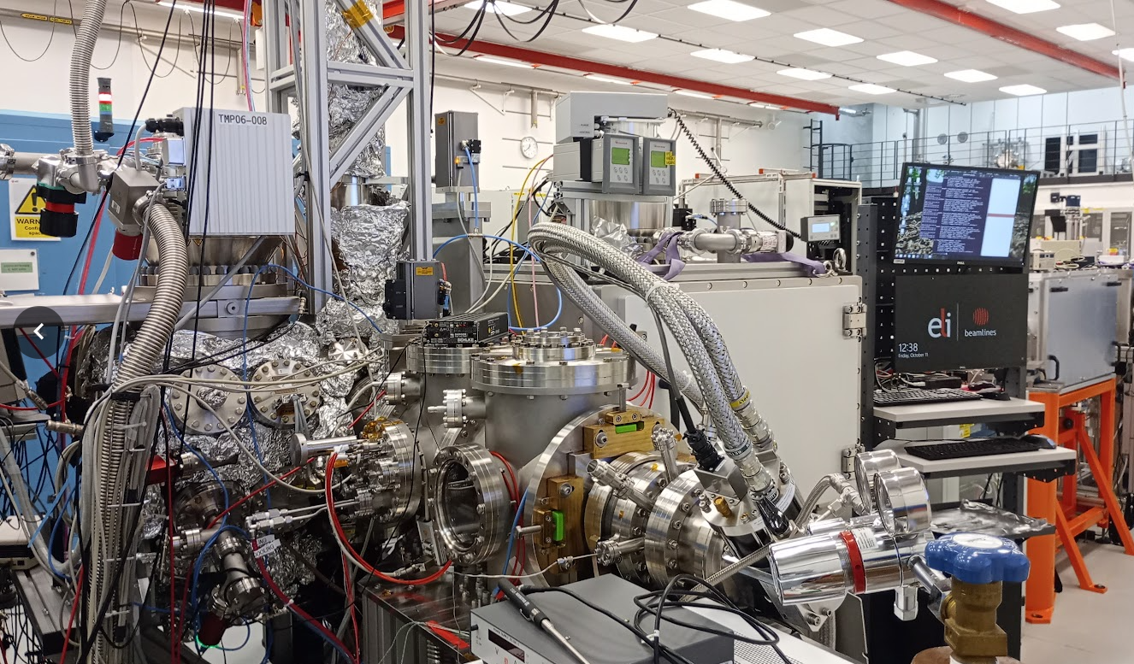
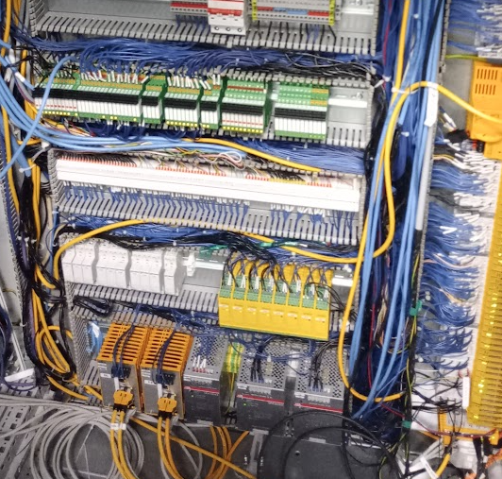
Present ELI Control Sysytem Teams
Two Control system Teams
Scientific Technology Controls & Data Infrastructure
9 members, IT infra, LabView Developers
Data Acquisition
Operation Support
Citizen Developer
Controls Hardware Integration
12 members, LabView Developers, Installation technicians, Electrical Design
Vacuum Control
Motion
Machine Safety
Personal Safety
IT Infrastructure
Shared responsibility from CS and IT

Slide 12
The Future
Our Challenges
Unification of CS Vision
We are looking for options to settle on an optimal solution for our facility.
Switch to Operations
Create an operations support team to avoid overwhelming developers with support.
Improve the reliability of CS by chasing the root cause of each support case and mitigating core issues.
Unify CS to improve maintainability.
IT Infrastructure
Define responsibilities for IT infrastructure.
Separate IT and CS so that IT functions as a service for CS.
Cooperation
We want to improve our cooperation with other similar facilities to learn from and share our know-how.

Slide 13
Thank you! Any questions?

